Slide 1

Apollo institute of engineering
Bechelor of engineering
(final year project presentation)
Code : 2170001
Department : Information Technology
Semester : 8th

Slide 2
Project title : Eduwiz
Submitted by :
Sr no. | Name | Enrollment no.
1 | Vrushank patel | 151280116042

Slide 3
Abstract of Project
Project Eduwiz is the School management based project comes with all new features like Student management, Dashboards, Reports, Analytics, Database security, Data backup, Email and SMS Integration etc.

Slide 4
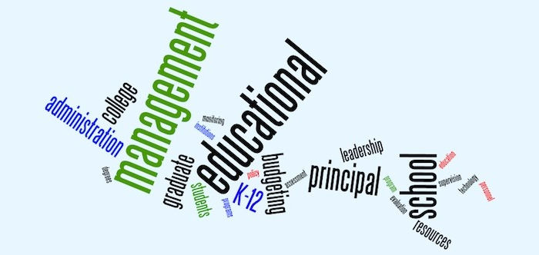
The educational management System is a typical information management system, including the establishment and maintenance of database and the development of front stage application program.

Slide 5

It requires a database of data consistency and integrity to build strong, full and good, and for the latter procedure, it requires full-functioned and easy to use and so on.
The main objective of the Management System is to manage the details of Schools, Students, Classes, Teachers, Registrations.

Slide 6

I am going create an application that will minimize all paper meets expectations and to keep the documents of the understudies and in the meantime the vital papers of the school a system that completely automated, easy to use, time successful and proficient.

Slide 7

Problem Definition
In huge amount of schools and specially in government schools, I’ve seen the only thing on which they store and retrieve the information or data, and that is bunch of papers and files.

Slide 8

Lots of notes, files, exam papers, records, students records, student reports and report cards, fees records, and lots of files they use for manage the academic purposes.
It is really too complicated to manage the academic data from files and bunches of papers.

Slide 9
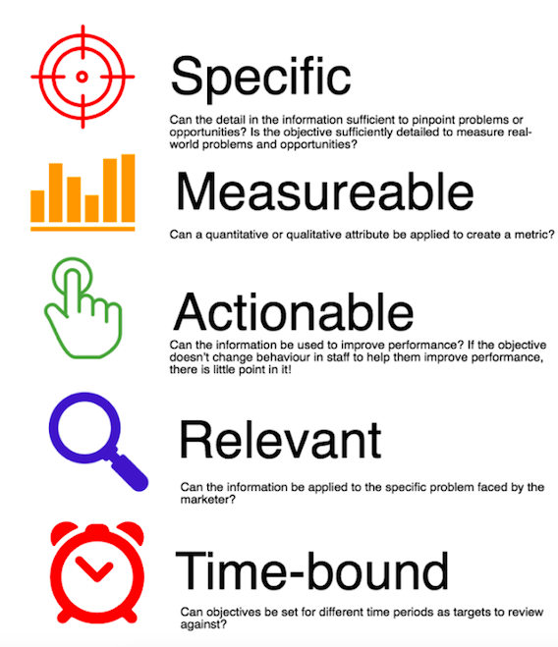
SMART
This whole management system needs to smart and secure and for that, they needs the academic and educational organizer assist application which I am going to make.

Slide 10

Need of Project

Slide 11
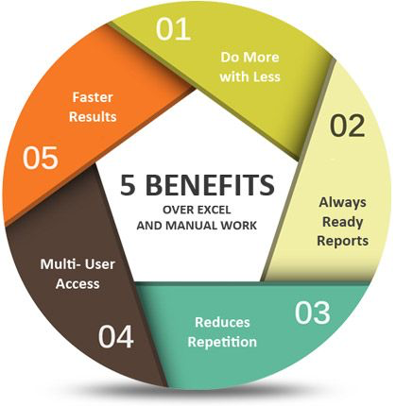
Benefits and Data as key player

Slide 12
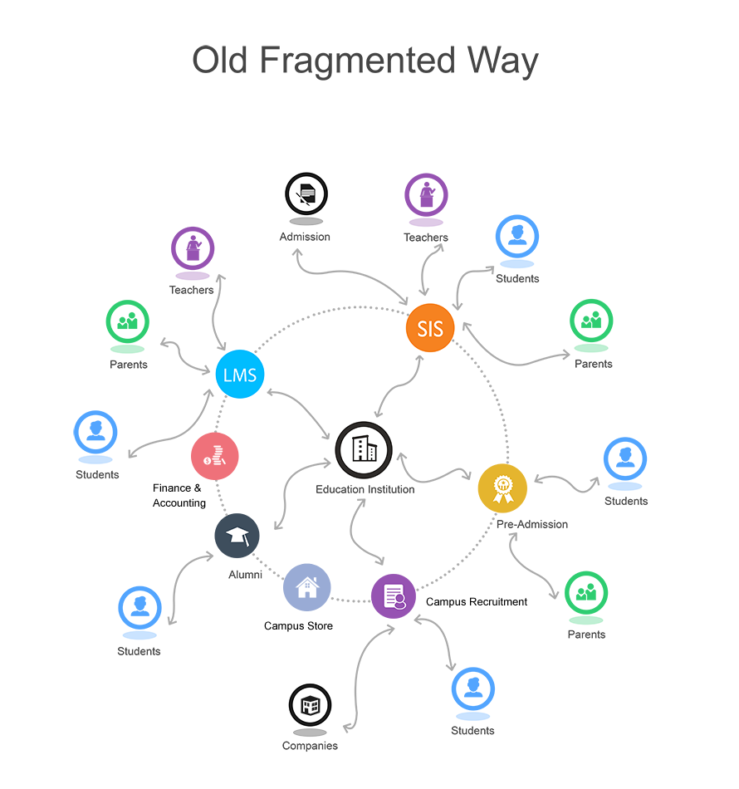
Old way

Slide 13
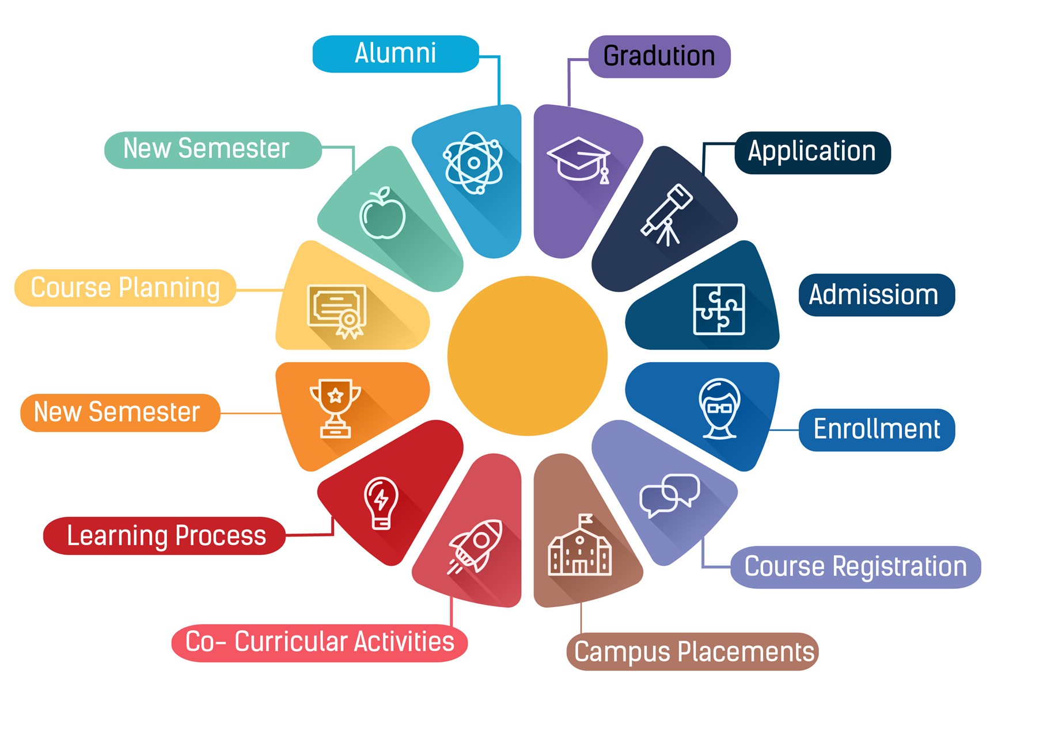
Objectives
Student Lifecycle Management

Slide 14
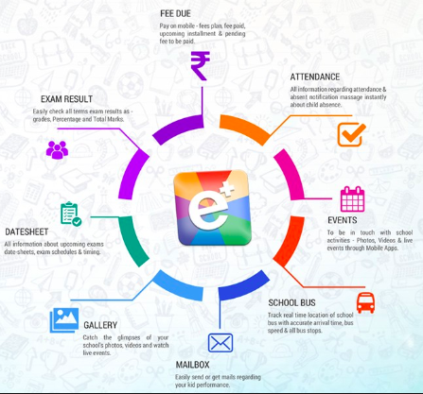
Email and SMS integration

Slide 15
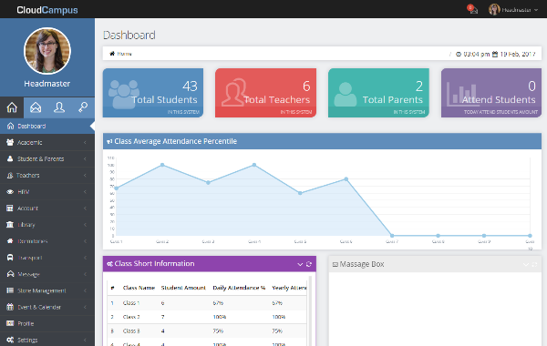
Dashboards, Reports and Analytics

Slide 16
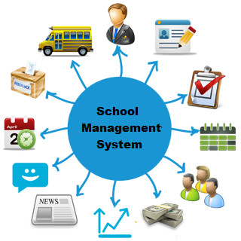
Backup and Security of data

Slide 17
Project goal and purpose
The purpose of developing the Academic management system of any organization is that to make easy to management to store a large number of data/reports into the computer.
It is difficult for any management to store the large number of data manually or in papers.
In that case when any user wants to take information it is very difficult for management to provide information immediately. It is very time consuming process. But by using computer it takes only few minutes/seconds.
SMS is intended to help the any institute that wants to store their students and management records into the computer.

Slide 18
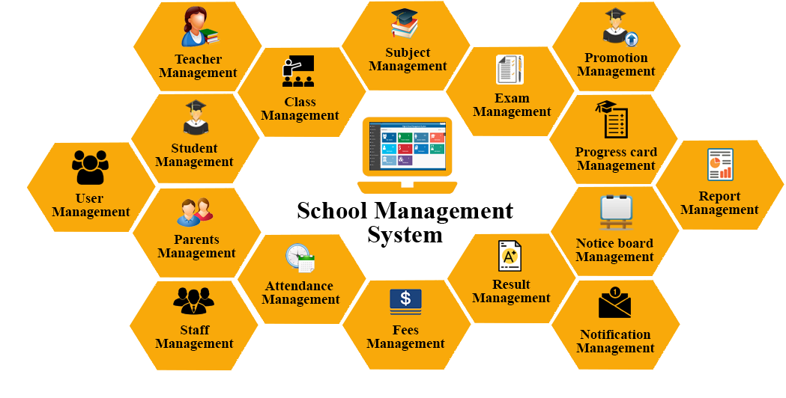

Slide 19
Advantages of project
Following are some of the major benefits of academic management application various entities in an educational institution.
To Management
To Administration
To Parents
To Teachers
To Students

Slide 20
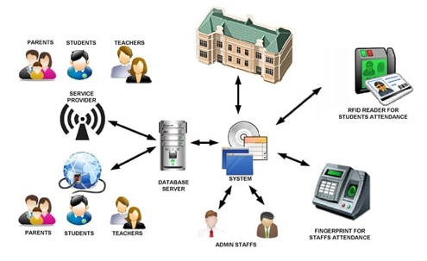
How it will work?

Slide 21
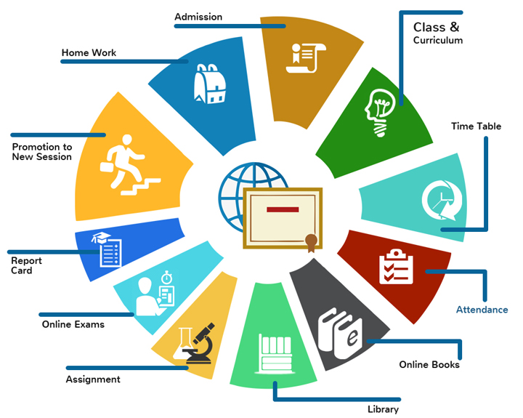
What it will contain?

Slide 22
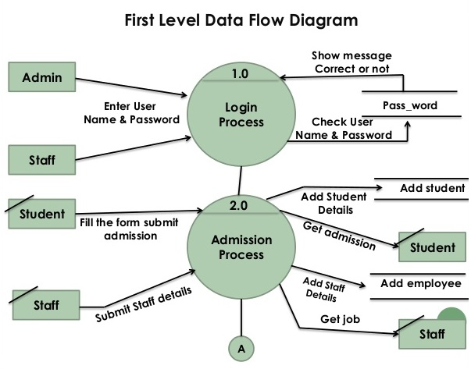
Data flow diagram

Slide 23
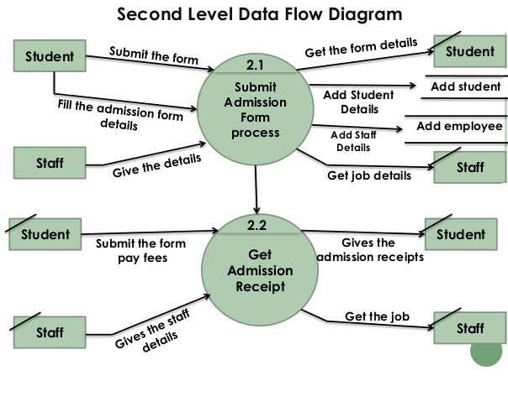
Data flow diagram

Slide 24
General Benefits
Single software to manage all School-related information from anywhere in the School
Easy to use school software/college software
Reliable and secure software
Low Cost of Ownership
Complete Automation of operations
More Time to focus on Strategic Tasks
Better informed decision making for management
Multiple Campus Management
One-Time Cost to purchase the software
Parents have access to all academic information about their wards through the internet

Slide 25
Requirements
If we talk about the basic requirements to use this project after development, then it will basically a working PC which meets minimum requirements to use this project’s desktop application [if you’re going to use desktop application], and a working internet connection to provide connectivity to application.
You will also able to use web application.

Slide 26

Project Screenshots

Slide 27
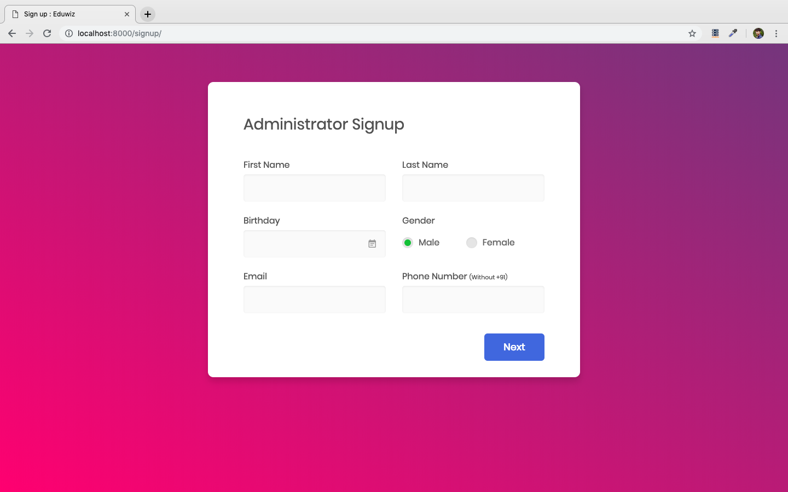
Administrator Signup form with django csrf security token to prevent attacks and exploits.

Slide 28
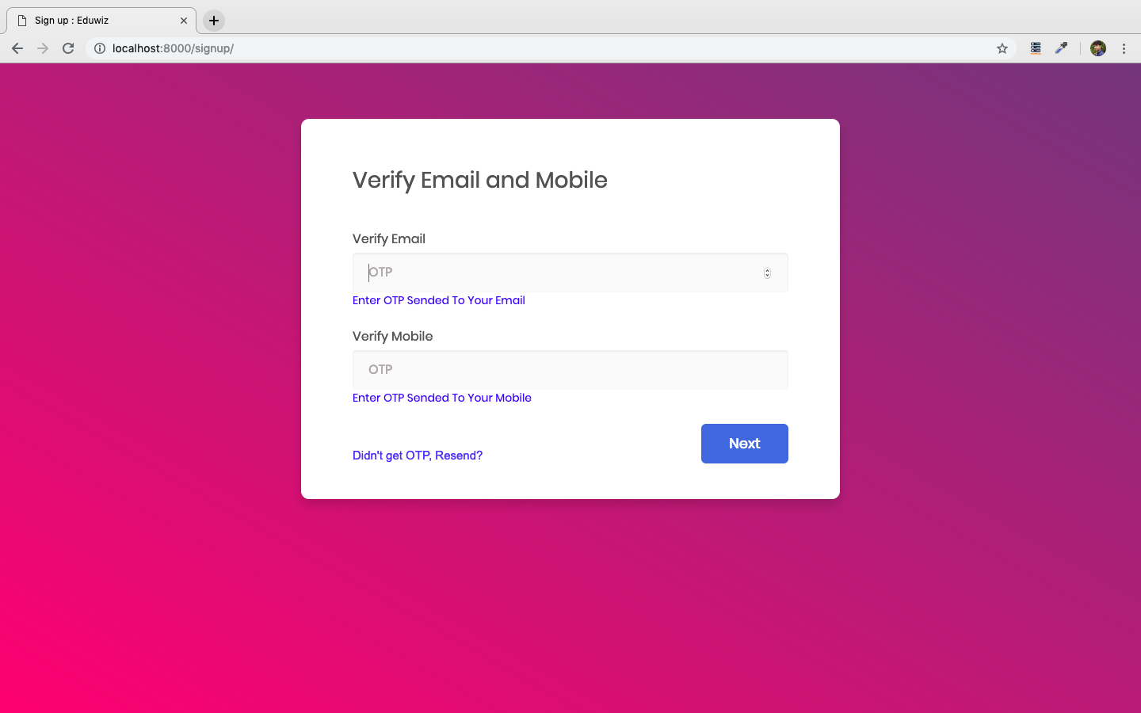
Email and mobile verification with security

Slide 29
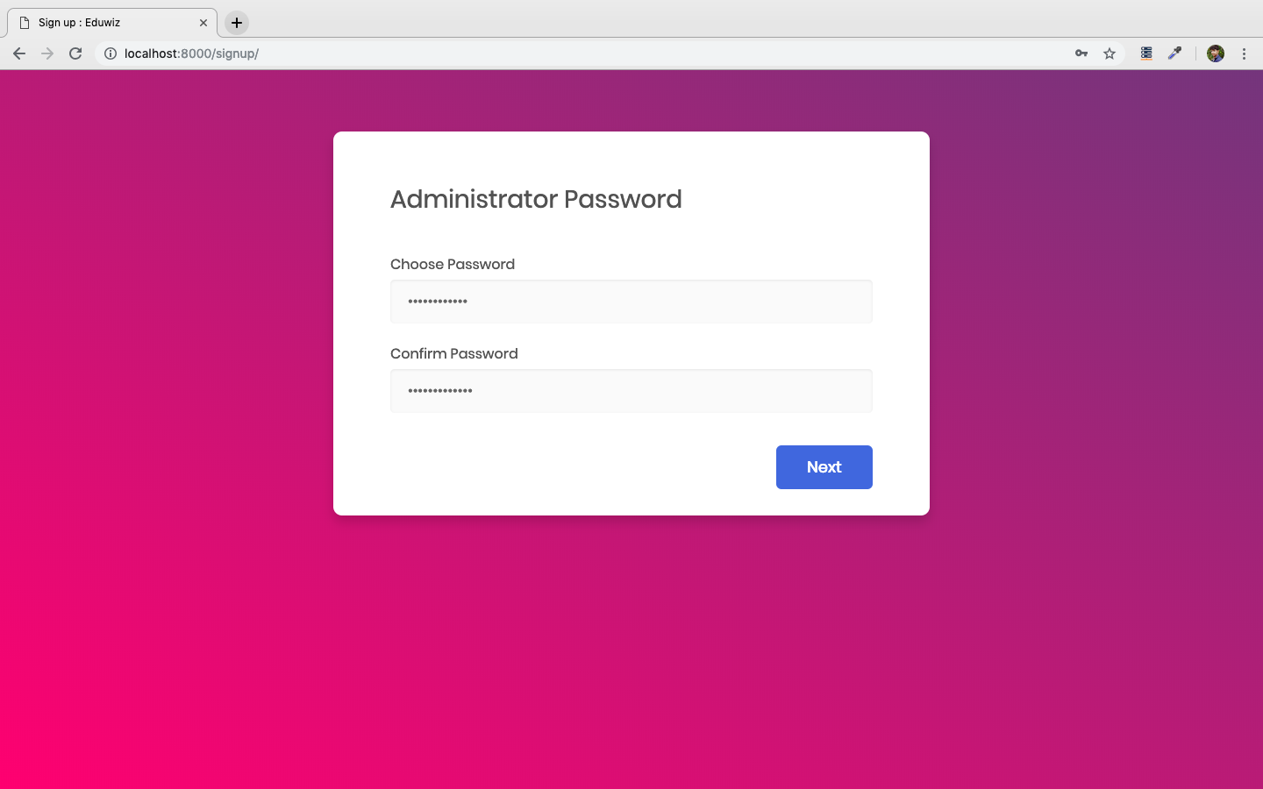
Secure admin account with RC4 Password encryption.

Slide 30
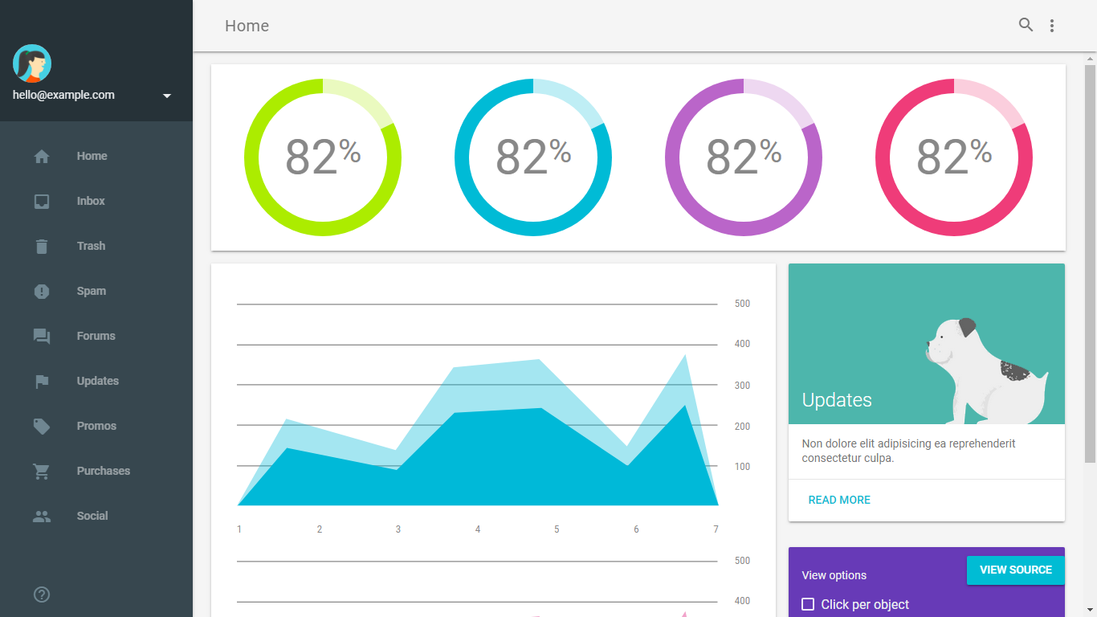

Slide 31
References
Researchgate
Studymode
Educationalsurvey
Creatly

Slide 32
Any Question…?

Slide 33
Thank you…!

